Slide 1
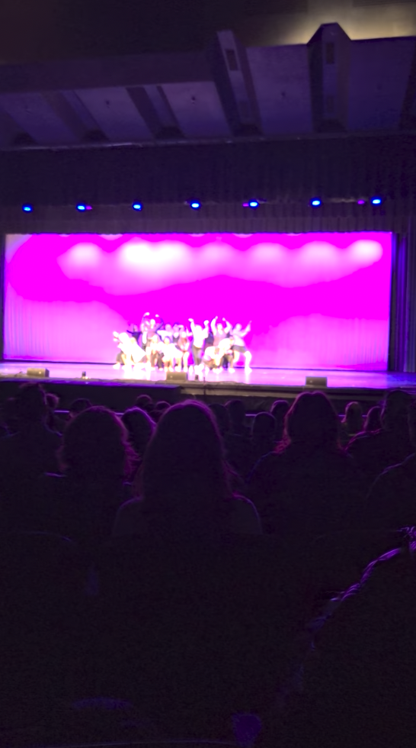

Shout-out to an amazing performance

Slide 2
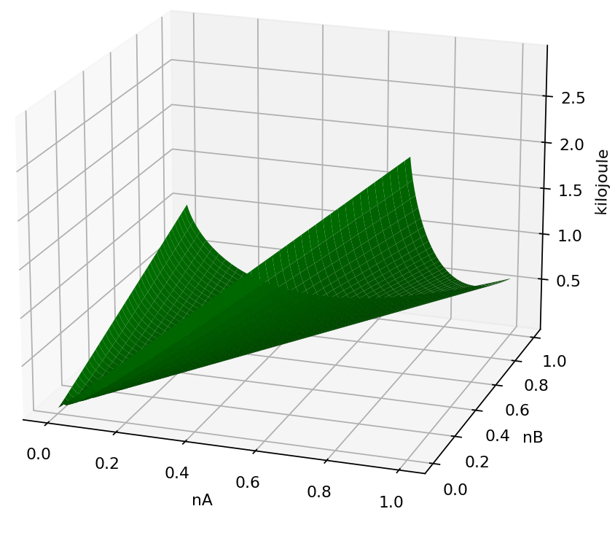
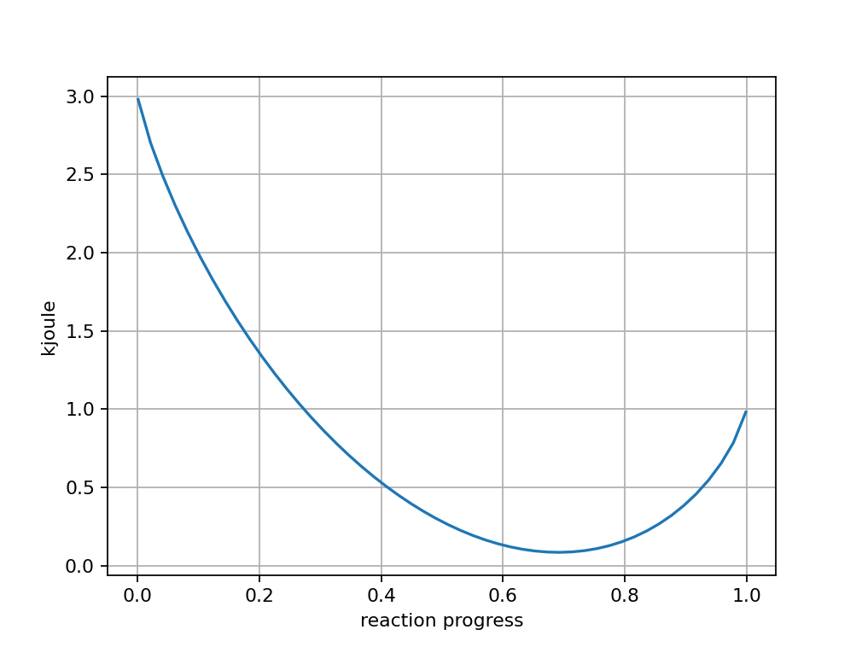

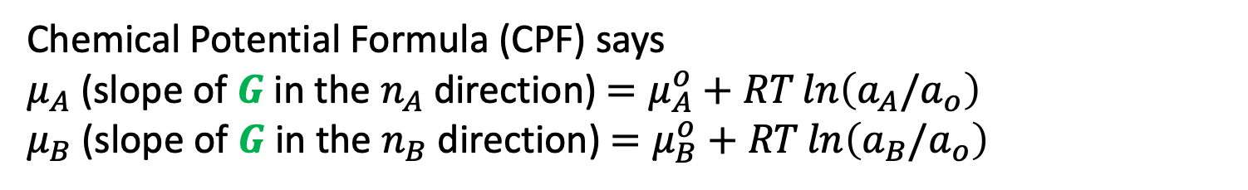


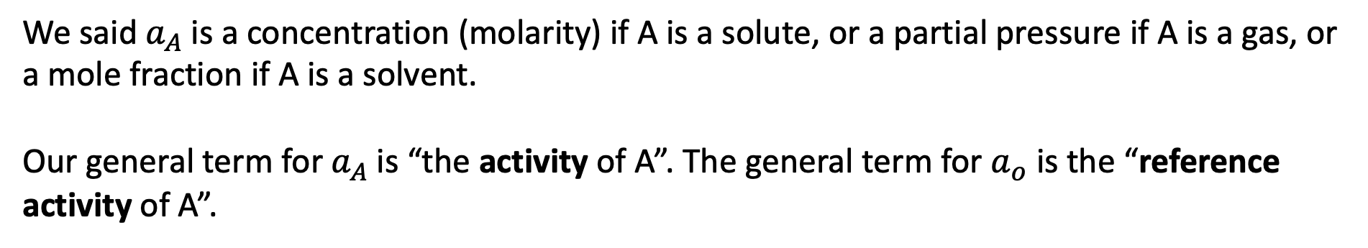


Recap
Chemical Potential Formula (CPF) says
$μ_{A}$(slope of $G$ in the $n_{A}$ direction) $=μ_{A}^{o}+RT\ln\left(a_{A}/a_{o}\right)$
$μ_{B}$(slope of $G$ in the $n_{B}$ direction) $=μ_{B}^{o}+RT\ln\left(a_{B}/a_{o}\right)$
$$G$$
$$G$$
${\left(\frac{∂G}{∂ε}\right)}_{rxn}$ $≡∆G_{rxn}\left(ε\right)$
$$ε$$
$$ε$$
We said $a_{A}$ is a concentration (molarity) if A is a solute, or a partial pressure if A is a gas, or a mole fraction if A is a solvent.
Our general term for $a_{A}$ is “the activity of A”. The general term for $a_{o}$ is the “reference activity of A”.

Slide 3
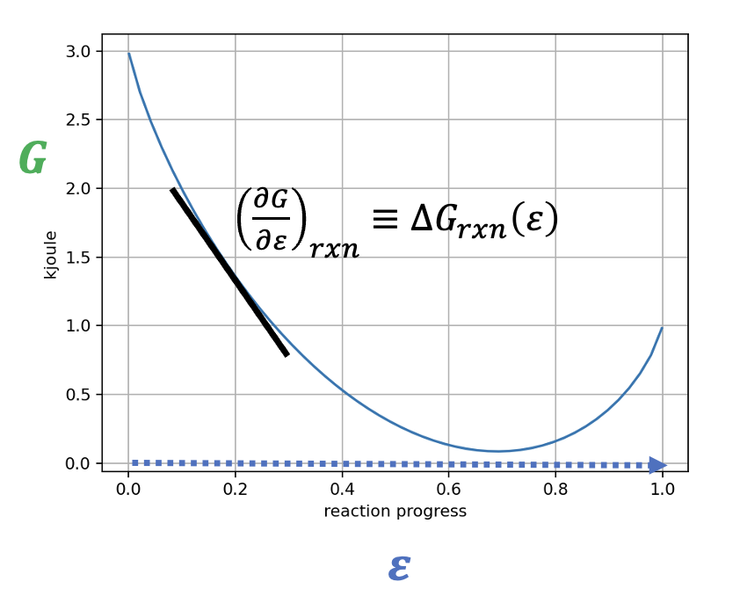
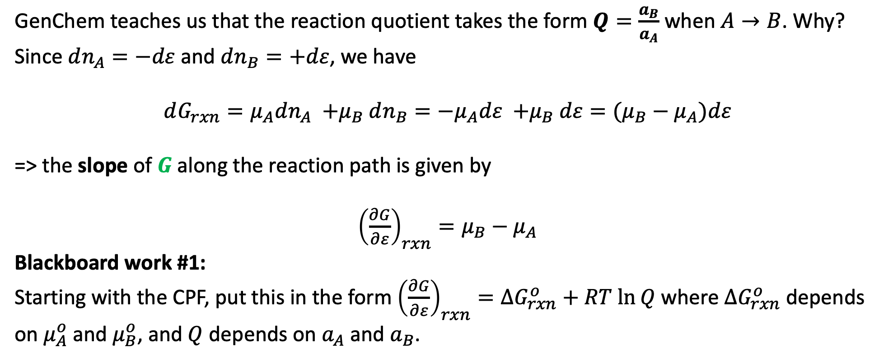
Why the reaction quotient $Q$ (and equilibrium constant $K$) have activities raised to stoichiometric coefficients
GenChem teaches us that the reaction quotient takes the form $Q=\frac{a_{B}}{a_{A}}$ when $A→B$. Why? Since $dn_{A}=−dε$ and $dn_{B}=+dε$, we have
$$dG_{rxn}={μ_{A}dn_{A} {+μ}_{B}dn_{B}=−μ}_{A}dε {+μ}_{B}dε=(μ_{B}−μ_{A})dε$$
=> the slope of $G$ along the reaction path is given by
${\left(\frac{∂G}{∂ε}\right)}_{rxn}=μ_{B}−μ_{A}$
Blackboard work #1:
Starting with the CPF, put this in the form ${\left(\frac{∂G}{∂ε}\right)}_{rxn}=∆G_{rxn}^{o}+RT ln⁡Q$ where $∆G_{rxn}^{o}$ depends on $μ_{A}^{o}$ and $μ_{B}^{o}$, and $Q$ depends on $a_{A}$ and $a_{B}$.

Slide 4
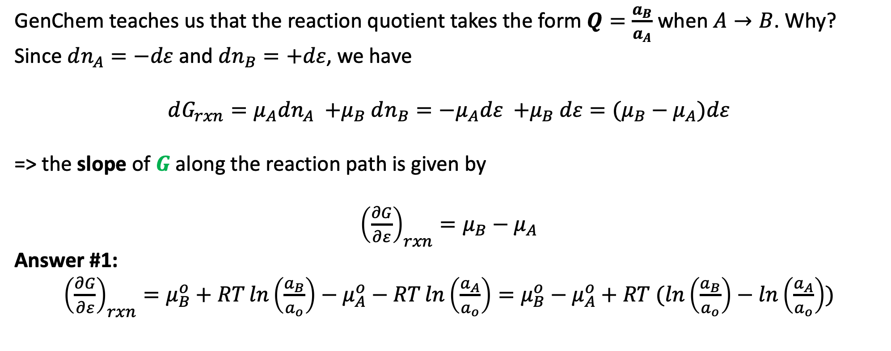
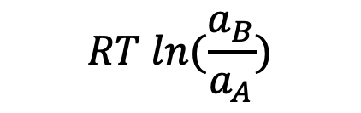

Why the reaction quotient $Q$ (and equilibrium constant $K$) have activities raised to stoichiometric coefficients
GenChem teaches us that the reaction quotient takes the form $Q=\frac{a_{B}}{a_{A}}$ when $A→B$. Why? Since $dn_{A}=−dε$ and $dn_{B}=+dε$, we have
$$dG_{rxn}={μ_{A}dn_{A} {+μ}_{B}dn_{B}=−μ}_{A}dε {+μ}_{B}dε=(μ_{B}−μ_{A})dε$$
=> the slope of $G$ along the reaction path is given by
${\left(\frac{∂G}{∂ε}\right)}_{rxn}=μ_{B}−μ_{A}$
Answer #1:
${\left(\frac{∂G}{∂ε}\right)}_{rxn}=μ_{B}^{o}+RT\ln\left(\frac{a_{B}}{a_{o}}\right)−μ_{A}^{o}−RT\ln\left(\frac{a_{A}}{a_{o}}\right)=μ_{B}^{o}−μ_{A}^{o}+RT (ln\left(\frac{a_{B}}{a_{o}}\right)−ln\left(\frac{a_{A}}{a_{o}}\right))$
$$∆G_{rxn}^{o}$$
$$RT ln(\frac{a_{B}}{a_{A}})$$

Slide 5

Why the reaction quotient $Q$ (and equilibrium constant $K$) have activities raised to stoichiometric coefficients
GenChem teaches us that the reaction quotient takes the form $Q=\frac{a_{B}}{a_{A}}$ when $A→B$. Why? Since $dn_{A}=−dε$ and $dn_{B}=+dε$, we have
$$dG_{rxn}={μ_{A}dn_{A} {+μ}_{B}dn_{B}=−μ}_{A}dε {+μ}_{B}dε=(μ_{B}−μ_{A})dε$$
=> the slope of $G$ along the reaction path is given by
${\left(\frac{∂G}{∂ε}\right)}_{rxn}=μ_{B}−μ_{A}$
Answer #1:
${\left(\frac{∂G}{∂ε}\right)}_{rxn}=μ_{B}^{o}+RT\ln\left(\frac{a_{B}}{a_{o}}\right)−μ_{A}^{o}−RT\ln\left(\frac{a_{A}}{a_{o}}\right)=μ_{B}^{o}−μ_{A}^{o}+RT (ln\left(\frac{a_{B}}{a_{o}}\right)−ln\left(\frac{a_{A}}{a_{o}}\right))$
$$∆G_{rxn}^{o}$$
$$RT ln(\frac{a_{B}}{a_{A}})$$
$$Q$$

Slide 6
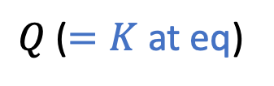
Why the reaction quotient $Q$ (and equilibrium constant $K$) have activities raised to stoichiometric coefficients
GenChem teaches us that the reaction quotient takes the form $Q=\frac{a_{B}}{a_{A}}$ when $A→B$. Why? Since $dn_{A}=−dε$ and $dn_{B}=+dε$, we have
$$dG_{rxn}={μ_{A}dn_{A} {+μ}_{B}dn_{B}=−μ}_{A}dε {+μ}_{B}dε=(μ_{B}−μ_{A})dε$$
=> the slope of $G$ along the reaction path is given by
${\left(\frac{∂G}{∂ε}\right)}_{rxn}=μ_{B}−μ_{A}$
Answer #1:
${\left(\frac{∂G}{∂ε}\right)}_{rxn}=μ_{B}^{o}+RT\ln\left(\frac{a_{B}}{a_{o}}\right)−μ_{A}^{o}−RT\ln\left(\frac{a_{A}}{a_{o}}\right)=μ_{B}^{o}−μ_{A}^{o}+RT (ln\left(\frac{a_{B}}{a_{o}}\right)−ln\left(\frac{a_{A}}{a_{o}}\right))$
$$∆G_{rxn}^{o}$$
$$RT ln(\frac{a_{B}}{a_{A}})$$
$Q$ ($=K$ at eq)

Slide 7
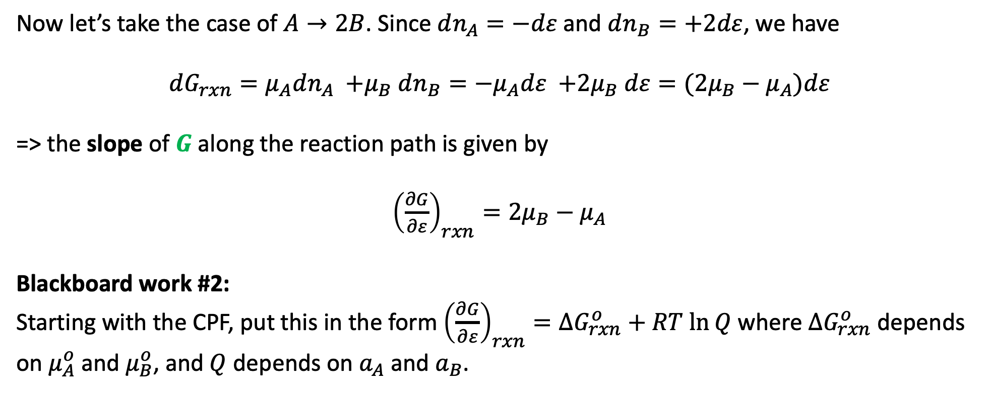
Why the reaction quotient $Q$ (and equilibrium constant $K$) have activities raised to stoichiometric coefficients
Now let’s take the case of $A→2B$. Since $dn_{A}=−dε$ and $dn_{B}=+2dε$, we have
$$dG_{rxn}={μ_{A}dn_{A} {+μ}_{B}dn_{B}=−μ}_{A}dε {+2μ}_{B}dε=({2μ}_{B}−μ_{A})dε$$
=> the slope of $G$ along the reaction path is given by
${\left(\frac{∂G}{∂ε}\right)}_{rxn}={2μ}_{B}−μ_{A}$
Blackboard work #2:
Starting with the CPF, put this in the form ${\left(\frac{∂G}{∂ε}\right)}_{rxn}=∆G_{rxn}^{o}+RT ln⁡Q$ where $∆G_{rxn}^{o}$ depends on $μ_{A}^{o}$ and $μ_{B}^{o}$, and $Q$ depends on $a_{A}$ and $a_{B}$.

Slide 8
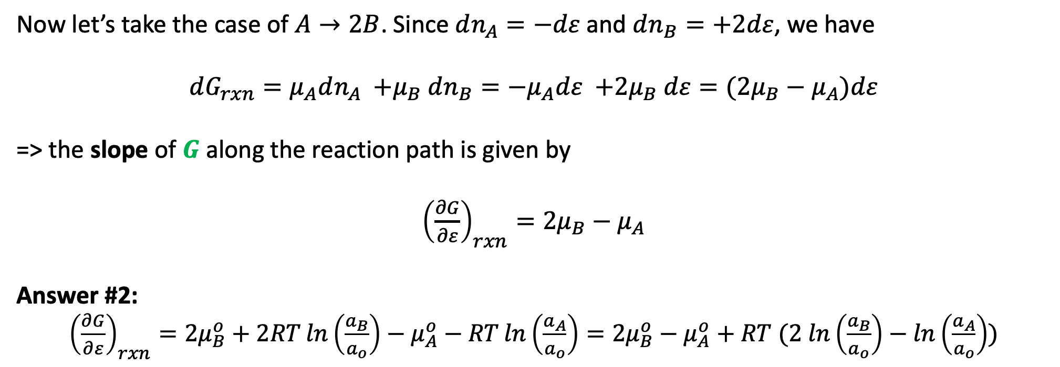


Why the reaction quotient $Q$ (and equilibrium constant $K$) have activities raised to stoichiometric coefficients
Now let’s take the case of $A→2B$. Since $dn_{A}=−dε$ and $dn_{B}=+2dε$, we have
$$dG_{rxn}={μ_{A}dn_{A} {+μ}_{B}dn_{B}=−μ}_{A}dε {+2μ}_{B}dε=({2μ}_{B}−μ_{A})dε$$
=> the slope of $G$ along the reaction path is given by
${\left(\frac{∂G}{∂ε}\right)}_{rxn}={2μ}_{B}−μ_{A}$
Answer #2:
${\left(\frac{∂G}{∂ε}\right)}_{rxn}={2μ}_{B}^{o}+2RT\ln\left(\frac{a_{B}}{a_{o}}\right)−μ_{A}^{o}−RT\ln\left(\frac{a_{A}}{a_{o}}\right)={2μ}_{B}^{o}−μ_{A}^{o}+RT (2 ln\left(\frac{a_{B}}{a_{o}}\right)−ln\left(\frac{a_{A}}{a_{o}}\right))$
$$RT ln(\frac{a_{B}^{2}}{a_{A}a_{o}})$$
$$∆G_{rxn}^{o}$$

Slide 9
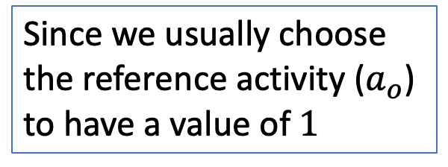
Why the reaction quotient $Q$ (and equilibrium constant $K$) have activities raised to stoichiometric coefficients
Now let’s take the case of $A→2B$. Since $dn_{A}=−dε$ and $dn_{B}=+2dε$, we have
$$dG_{rxn}={μ_{A}dn_{A} {+μ}_{B}dn_{B}=−μ}_{A}dε {+2μ}_{B}dε=({2μ}_{B}−μ_{A})dε$$
=> the slope of $G$ along the reaction path is given by
${\left(\frac{∂G}{∂ε}\right)}_{rxn}={2μ}_{B}−μ_{A}$
Answer #2:
${\left(\frac{∂G}{∂ε}\right)}_{rxn}={2μ}_{B}^{o}+2RT\ln\left(\frac{a_{B}}{a_{o}}\right)−μ_{A}^{o}−RT\ln\left(\frac{a_{A}}{a_{o}}\right)={2μ}_{B}^{o}−μ_{A}^{o}+RT (2 ln\left(\frac{a_{B}}{a_{o}}\right)−ln\left(\frac{a_{A}}{a_{o}}\right))$
$$RT ln(\frac{a_{B}^{2}}{a_{A}a_{o}})$$
Since we usually choose the reference activity ($a_{o}$) to have a value of $1$
$$∆G_{rxn}^{o}$$

Slide 10

Why the reaction quotient $Q$ (and equilibrium constant $K$) have activities raised to stoichiometric coefficients
Now let’s take the case of $A→2B$. Since $dn_{A}=−dε$ and $dn_{B}=+2dε$, we have
$$dG_{rxn}={μ_{A}dn_{A} {+μ}_{B}dn_{B}=−μ}_{A}dε {+2μ}_{B}dε=({2μ}_{B}−μ_{A})dε$$
=> the slope of $G$ along the reaction path is given by
${\left(\frac{∂G}{∂ε}\right)}_{rxn}={2μ}_{B}−μ_{A}$
Answer #2:
${\left(\frac{∂G}{∂ε}\right)}_{rxn}={2μ}_{B}^{o}+2RT\ln\left(\frac{a_{B}}{a_{o}}\right)−μ_{A}^{o}−RT\ln\left(\frac{a_{A}}{a_{o}}\right)={2μ}_{B}^{o}−μ_{A}^{o}+RT (2 ln\left(\frac{a_{B}}{a_{o}}\right)−ln\left(\frac{a_{A}}{a_{o}}\right))$
$$RT ln(\frac{a_{B}^{2}}{a_{A}})$$
Since we usually choose the reference activity ($a_{o}$) to have a value of $1$
$$∆G_{rxn}^{o}$$

Slide 11


Why the reaction quotient $Q$ (and equilibrium constant $K$) have activities raised to stoichiometric coefficients
Now let’s take the case of $A→2B$. Since $dn_{A}=−dε$ and $dn_{B}=+2dε$, we have
$$dG_{rxn}={μ_{A}dn_{A} {+μ}_{B}dn_{B}=−μ}_{A}dε {+2μ}_{B}dε=({2μ}_{B}−μ_{A})dε$$
=> the slope of $G$ along the reaction path is given by
${\left(\frac{∂G}{∂ε}\right)}_{rxn}={2μ}_{B}−μ_{A}$
Answer #2:
${\left(\frac{∂G}{∂ε}\right)}_{rxn}={2μ}_{B}^{o}+2RT\ln\left(\frac{a_{B}}{a_{o}}\right)−μ_{A}^{o}−RT\ln\left(\frac{a_{A}}{a_{o}}\right)={2μ}_{B}^{o}−μ_{A}^{o}+RT (2 ln\left(\frac{a_{B}}{a_{o}}\right)−ln\left(\frac{a_{A}}{a_{o}}\right))$
$$RT ln(\frac{a_{B}^{2}}{a_{A}})$$
$$∆G_{rxn}^{o}$$
$$Q$$

Slide 12
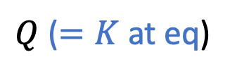
Why the reaction quotient $Q$ (and equilibrium constant $K$) have activities raised to stoichiometric coefficients
Now let’s take the case of $A→2B$. Since $dn_{A}=−dε$ and $dn_{B}=+2dε$, we have
$$dG_{rxn}={μ_{A}dn_{A} {+μ}_{B}dn_{B}=−μ}_{A}dε {+2μ}_{B}dε=({2μ}_{B}−μ_{A})dε$$
=> the slope of $G$ along the reaction path is given by
${\left(\frac{∂G}{∂ε}\right)}_{rxn}={2μ}_{B}−μ_{A}$
Answer #2:
${\left(\frac{∂G}{∂ε}\right)}_{rxn}={2μ}_{B}^{o}+2RT\ln\left(\frac{a_{B}}{a_{o}}\right)−μ_{A}^{o}−RT\ln\left(\frac{a_{A}}{a_{o}}\right)={2μ}_{B}^{o}−μ_{A}^{o}+RT (2 ln\left(\frac{a_{B}}{a_{o}}\right)−ln\left(\frac{a_{A}}{a_{o}}\right))$
$$RT ln(\frac{a_{B}^{2}}{a_{A}})$$
$$∆G_{rxn}^{o}$$
$Q$ ($=K$ at eq)

Slide 13
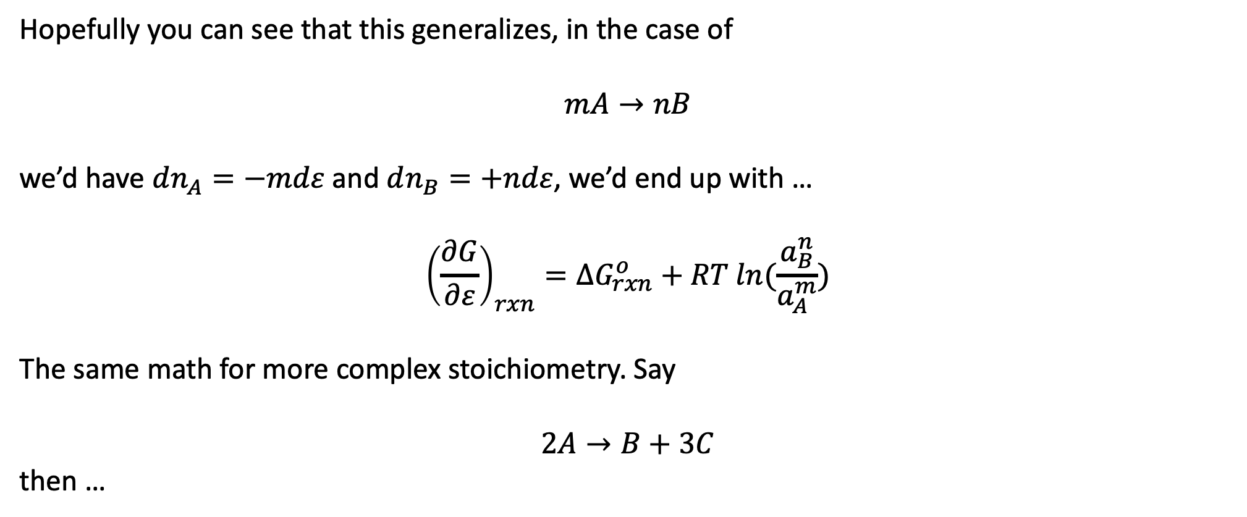
Why the reaction quotient $Q$ (and equilibrium constant $K$) have activities raised to stoichiometric coefficients
Hopefully you can see that this generalizes, in the case of
$$mA→nB$$
we’d have $dn_{A}=−mdε$ and $dn_{B}=+ndε$, we’d end up with …
$${\left(\frac{∂G}{∂ε}\right)}_{rxn}=∆G_{rxn}^{o}+RT ln(\frac{a_{B}^{n}}{a_{A}^{m}})$$
The same math for more complex stoichiometry. Say
$$2A→B+3C$$
then …

Slide 14
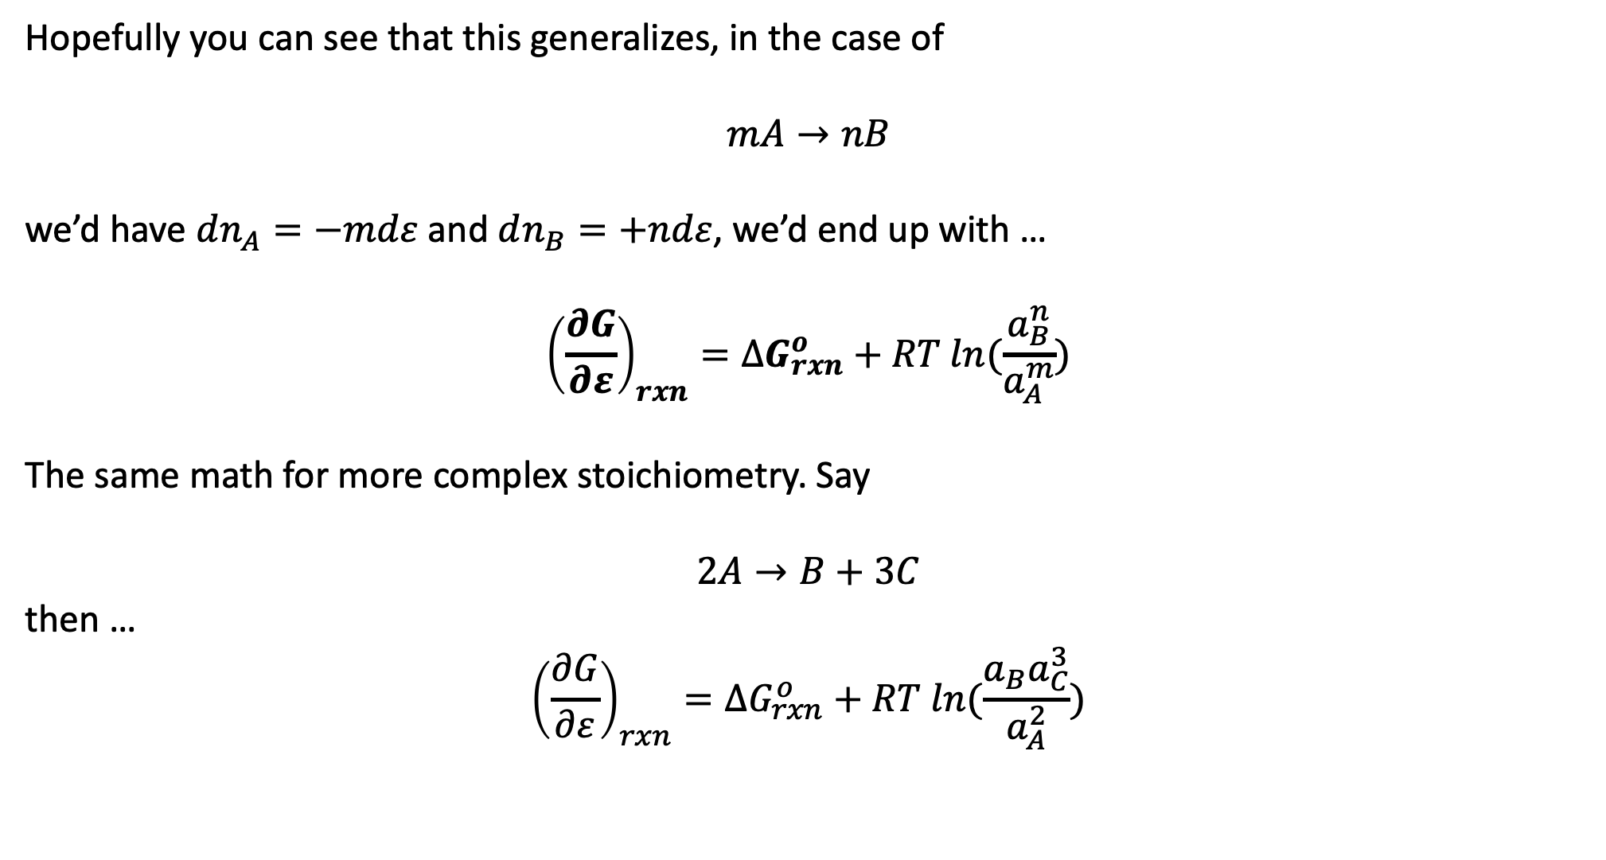
Why the reaction quotient $Q$ (and equilibrium constant $K$) have activities raised to stoichiometric coefficients
Hopefully you can see that this generalizes, in the case of
$$mA→nB$$
we’d have $dn_{A}=−mdε$ and $dn_{B}=+ndε$, we’d end up with …
$${\left(\frac{∂G}{∂ε}\right)}_{rxn}=∆G_{rxn}^{o}+RT ln(\frac{a_{B}^{n}}{a_{A}^{m}})$$
The same math for more complex stoichiometry. Say
$$2A→B+3C$$
then …
$${\left(\frac{∂G}{∂ε}\right)}_{rxn}=∆G_{rxn}^{o}+RT ln(\frac{a_{B}a_{C}^{3}}{a_{A}^{2}})$$

